Slide 1

BELIEFS, VALUES AND ATTITUDES
This Photo by Unknown Author is licensed under CC BY-SA-NC

Slide 2

Tell your partner…
Tell the person opposite you what you think a:
Belief is..
Value is..
Attitude is..

Slide 3

Beliefs
Definition of Belief: A person’s sense of right and wrong and assumptions made about things encountered in life or what is believed to be real and true. They differ in intensity depending on the subject they are being held on ie. Stronger belief about more important subjects.
E.g. Person A might believe that being vegetarian is the healthiest way to live. Not eating meat is important Another person may disagree and love eating meat
E.g. Person A may believe that Jesus live, died and rose again. This would be a strong belief. Person B may not have a strong belief either way
Turn to your partner and come up with another example…
This Photo by Unknown Author is licensed under CC BY

Slide 4
What are some commonly held beliefs amongst young people in Australia?

Slide 5
Where do these beliefs come from?
SELF GENERATED | EXTERNALLY GENERATED
EXPERIENCE | EXPERTS
REFLECTION | AUTHORITY

Slide 6
SELF GENERATED
EXPERIENCE:
- Based on a cause and effect relationship.
A person believes that alcohol makes you drunk. The person believes this to be true as they have tried alcohol and have noticed the effects it has had on the body.
This is the STRONGEST way to form a belief and the belief is unlikely to be changed.
REFLECTION
- An individual internally reflects on experiences, observations, personal opinion and the viewpoints of others to generate their own beliefs.

Slide 7
EXTERNALLY GENERATED
Experts
People tend to believe the experts advice or guidance as their knowledge in the area is trusted and respected.
Individuals may believe studies and experiments that have been conducted by doctors or experts in the field that are supported by data and evidence.
Eg. Alcohol consumption and liver disease.
VIDEO: Does Sugar cause Heart Disease-The Drs. (4 mins)
Authority
People believe those that hold a perceived level of power (usually in a position of leadership) based on the title that they hold.
Eg. Parent/child regarding alcohol.

Slide 8
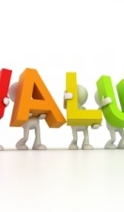
Values
Definition
general principles, morals and standards by which one lives their life. These can be positive or negative. Not specific to an object or situation but are the moral standards that an individual uses to make decisions, determine ethical behaviour or standards of conduct
Can be changed depending on socioeconomic factors.
Will be acquired from a young age, core values will provide a basis for the rest of our values.
Based on culture, ethnicity, demographics and other factors such as peers.
Values will influence a persons beliefs, which in turn will determine behaviour.
This Photo by Unknown Author is licensed under CC BY-NC-ND

Slide 9

Values
An example of values in action
Borussia Dortmund Values and
The Yellow Wall

Slide 10
CORE VALUES
BRAINSTORM

Slide 11
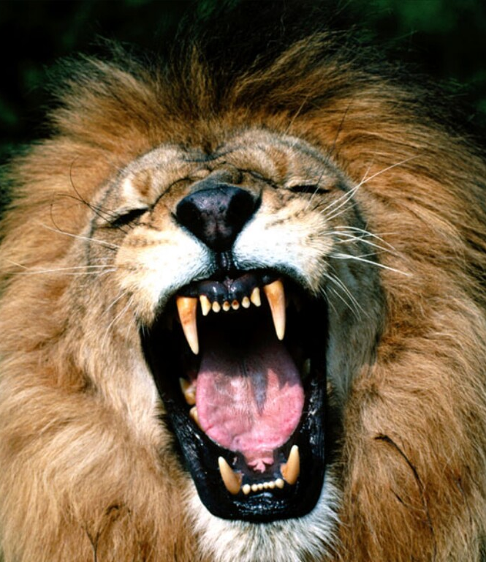
Attitude
A different perspective
https://www.youtube.com/watch?v=kVOr62MSZjU
This Photo by Unknown Author is licensed under CC BY

Slide 12
Attitudes
Definition
positive or negative opinions or feelings individuals attach to objects, people or situations. Attitudes have 3 components: Cognitive – thoughts and beliefs people hold, affective – emotional feelings, behavioural – predispositions to act in certain ways .

Slide 13
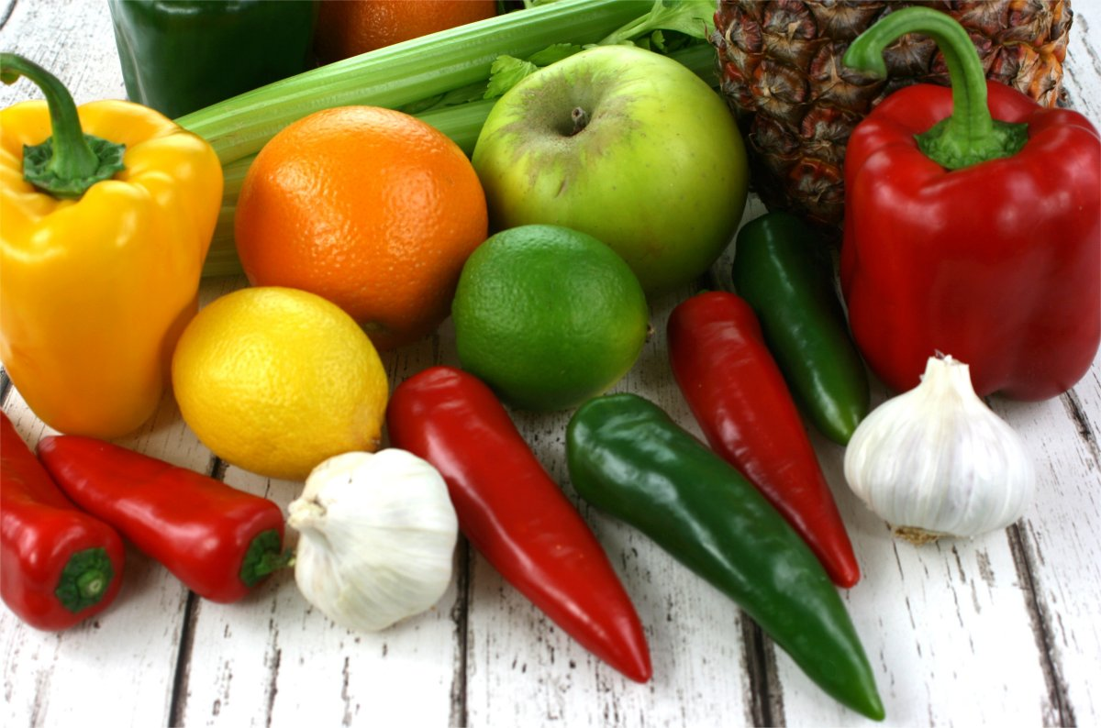
How to BVA’s impact Behaviour?
Beliefs + Value + Attitude = Behaviour
 | Belief | Value | Attitude | Behaviour | Impact on Health
Plant based diet | Eating mostly a plant-based diet is best | Quality of life and longer life | Positive thoughts about eating a vege burger | Will eat a vege burger | Most likely better for health status. Decreased risk of CHD, diabetes, obesity ect
Recreational drugs | Achieving pleasure in life is the most important factor | Feeling good and having pleasure | Positive towards anything that causes pleasure
Annual skin checkup

Slide 14
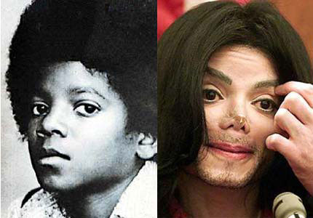
We have attitudes about…

Slide 15
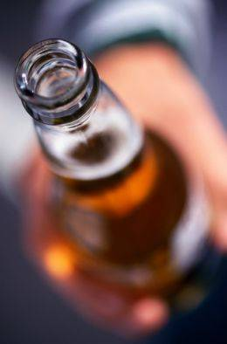

Slide 16
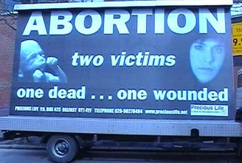

Slide 17
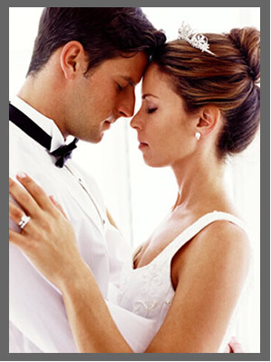

Slide 18


Slide 19


Slide 20

This Photo by Unknown Author is licensed under CC BY-SA

Slide 21

This Photo by Unknown Author is licensed under CC BY-SA-NC

Slide 22
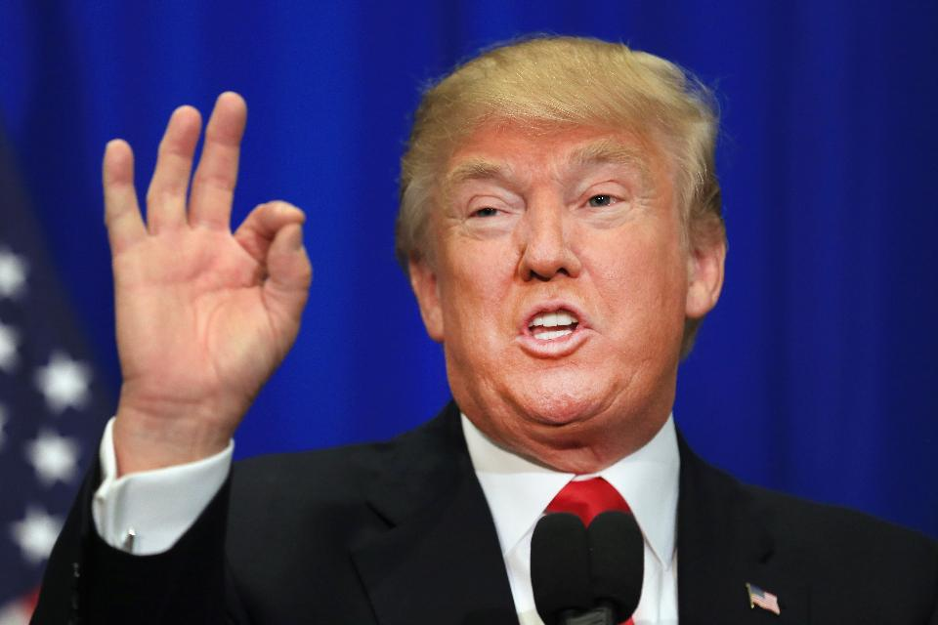

Slide 23
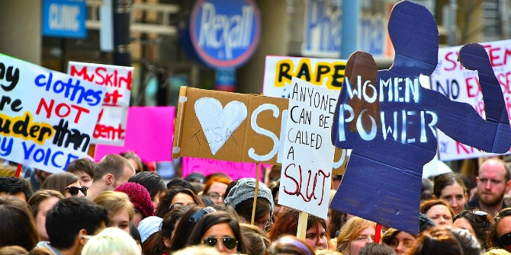
Feminism
This Photo by Unknown Author is licensed under CC BY-NC

Slide 24
How to BVA’s impact Behaviour?
Beliefs + Value + Attitude = Behaviour
 | Belief | Value | Attitude | Behaviour | Impact on Health
Plant based diet | Eating mostly a plant-based diet is best | Quality of life and longer life | Positive thoughts about eating a vege burger | Will eat a vege burger | Most likely better for health status. Decreased risk of CHD, diabetes, obesity ect
Recreational drugs | Achieving pleasure in life is the most important factor | Feeling good and having pleasure | Positive towards anything that causes pleasure
Annual skin checkup

Slide 25
Positive Media Influence
The media will aim to change beliefs by presenting new information, using values to their advantage and convincing the consumer that they need the product.
https://www.youtube.com/watch?v=8KQ-qRtdoSQ
What beliefs are being targeted in this advert?
What behavior does the producer of this advert want to adopt?
How have they targeted the beliefs of the target audience?
https://www.youtube.com/watch?v=XjJQBjWYDTs&t=133s
The media will try to change beliefs in order to influence peoples attitudes towards their product.
Messages delivered by the media imply that they represent societies values. Individuals will choose to, consciously or not, take on these values.
Reading
Text: Pages 68-71

Slide 26
Negative Media Influence
How can media negatively influence our beliefs?
Sometimes this can backfire and causes issues
https://www.youtube.com/watch?v=zJENOWWdzzs 5:50. 10 Offensive ad campaigns

Slide 27
Your turn
Pick a piece of media (TV show, movie, magazine, advertisement)
Analyse this piece of media:
How does this piece of media influence a person’s belief?
How might this piece of media influence a person’s behaviour specific to health?

Slide 28
How does media work?
Physical and structural factors can create opportunity, incentive or barriers which influences ability to partake in healthy behaviour. The media will try to influence these factors.
Opportunity- Jetts ad
Media will use limited opportunity in order to create fast action that may not have been desired if not for the media message.
Incentives-
The media will sell a certain product creating an expectation of certain outcomes. Want 6 pack abs?
http://www.healthguidance.org/entry/2136/1/Tone-Abs-With-Electronic-Muscle-Stimulator-Can-Body-Fat-Melt-Away.html
Barriers-
The media will also sell solutions to perceived barriers. These can be both positive or negative. https://www.youtube.com/watch?v=MP77JOrD-WE
https://imgur.com/gallery/oUbUG

Slide 29
Social Networks
Each person in a social network will be connected through either a one-way tie, or a two-way tie.
One-way: information flows from one person to another
Two-way: information flows back and forth between two people
When looking at beliefs, attitudes and values look at who you interact with, and who they interact with as well.
A persons beliefs may be influenced by someone in their social network who they do not directly interact with.
Reading
Textbook page 72

Slide 30
Connectedness
People involved in highly connected networks will be more influenced than those with minimal connectedness.
If someone in a tightly connected network changes their beliefs about a certain topic, this change could spread through the network very quickly.
https://www.youtube.com/watch?v=2U-tOghblfE

Slide 31
VIDEO
Nicholas Christakis
“The hidden influence of social networks”
https://www.youtube.com/watch?v=2U-tOghblfE

Slide 32
Source
Lockhart, E. (2010). Health Studies Stage 2A-b. Madeley: Print Publishing.
Image from:
http://www.minionmovie.com.au/

Slide 33
Quiz

Slide 34
SEMESTER ONE EXAM

Slide 35
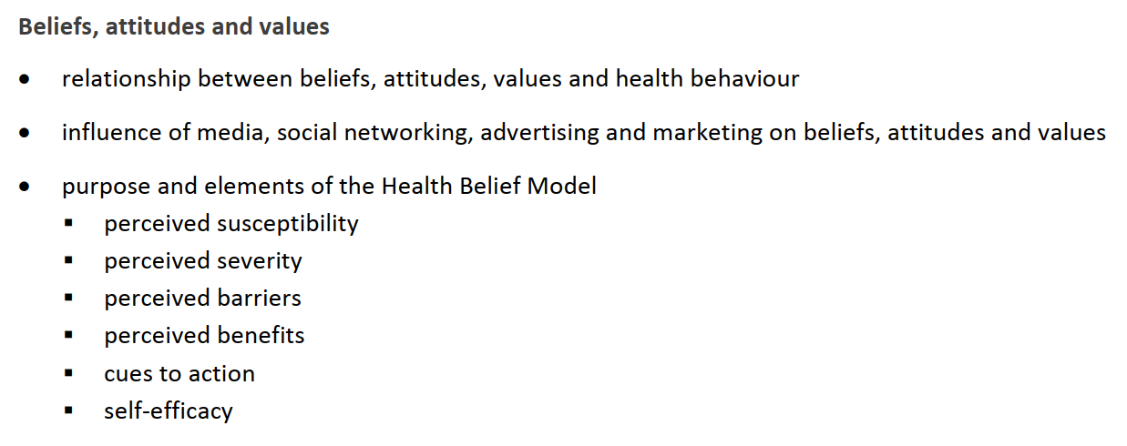
Syllabus points

Slide 36

Health Belief Model
This Photo by Unknown Author is licensed under CC BY-SA

Slide 37
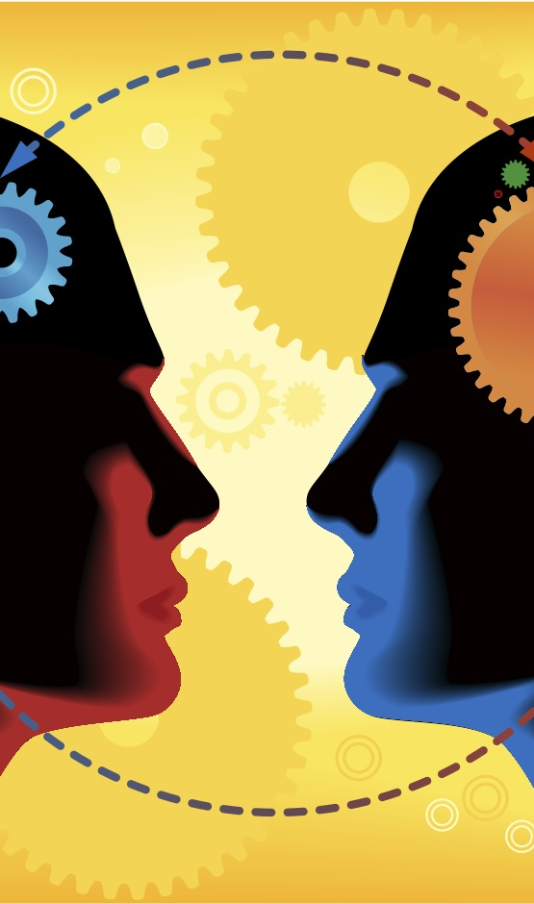
Question to Consider…
If we consider ourselves to be completely healthy and at no risk (or very minimal risk) of illness or disease, would we be motivated to:
Seek medical help?
Be regularly screened/tested?
Be immunized?
This Photo by Unknown Author is licensed under CC BY-NC-ND

Slide 38
HBM is a health promotion tool that aims to change behaviour
All Preventative strategies require the individual to be MOTIVATED to participate in the strategy.
Eg. Health Professionals have to convince the public to have immunisations.
https://www.youtube.com/watch?v=6iVi5EmlewI
The HEALTH BELIEF MODEL helps us to understand the FACTORS that influence our motivation to participate in health preventative strategies.

Slide 39
Health Belief Model
Created in the 1950s in response to a failed, free tuberculosis screening program…
WHY did people not want to use this FREE health prevention strategy???
The HBM examines attitudes and perceptions towards the issue.
The HBM assumes that behaviour change occurs with the existence of three ideas at the same time
An individual recognizes that there is enough reason to make a health concern relevant (susceptibility and severity)
The person understands he or she may be vulnerable to a diseas or a negative health outcome (perceived threat)
Individual must realise that behaviour change can be beneficial and will outweigh any costs

Slide 40
Examples of preventive strategies:
Immunisation
Screening (formal and informal)
Wearing seatbelts
Wearing a helmet
Taking medication
Taking a first aid course
Come up with two more of your own ideas >>

Slide 41
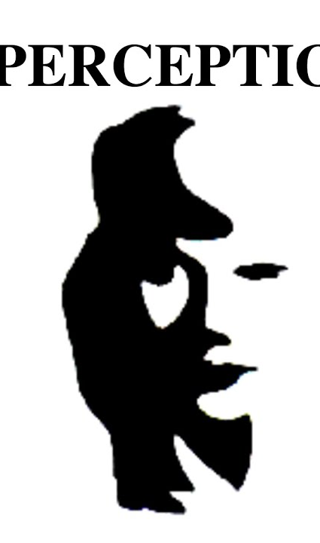
Definition
Perception:
The act of “Perceiving” The ability to SENSE something, to analyse what is going on and make sense of it in their mind. People use their attitudes and beliefs to help them decipher messages and process what is going on.
Ie. Someone who is “perceptive” is very good at analysing and processing what is going on around them (usually unconsciously using their attitudes and beliefs)
This Photo by Unknown Author is licensed under CC BY-SA-NC

Slide 42
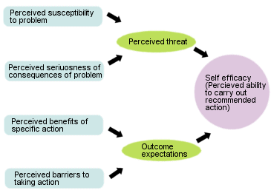
Health Belief Model

Slide 43


Perceived Susceptibility:
The Risk a person has to a particular disease or health outcome.
HBM:
*It examines the individuals opinions about HOW LIKELY the behaviours they partake in are going to lead to a negative health outcome

Slide 44
Perceived Severity/Seriousness:
How serious the disease that a person is susceptible to can be.
HBM:
*seeks to increase awareness of how serious the health outcomes of behaviours can be.

Slide 45

Perceived Threat:
How we feel about the disease in question. Ie. Is it a concern for us?
Includes 2 processes:
Perceived Susceptibility
Perceived Severity/Seriousness

Slide 46
Perceived Benefits:
What are the BENEFITS of participating in the prevention strategy??
The individual must be convinced that the intervention is SAFE and will WORK.
*HBM:
The GOAL is better Quality of Life for the individual.

Slide 47
Perceived Barriers:
Why should I NOT PARTICIPATE in this prevention strategy?
Eg. Losing friends, money, fear of change to lifestyle etc.
*HBM:
For change to happen, the individual must BELIEVE that the benefits outweigh the barriers.

Slide 48
Outcome Expectations:
The perception of the individual that the suggested intervention will actually work.
Determined by 2 factors:
Perceived Benefits
Perceived Barriers

Slide 49
Self Efficacy:
An individuals self belief that they can carry out an action.
*HBM:
Outcome expectations and perceived threat can have an impact on ones perceived ability to participate in an intervention for their health.

Slide 50
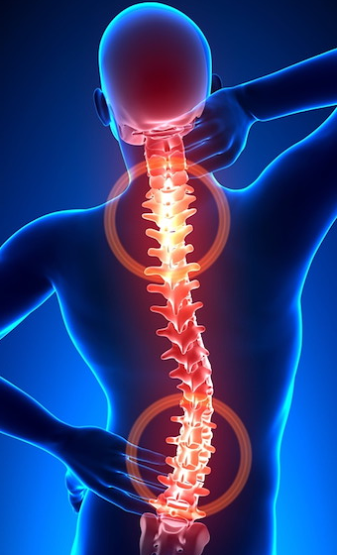
Cues to Action
Internal: pain, illness.
External: illness/pain of someone close to you, the media, product health warning labels etc.
Eg. Postcard reminder from the dentist for your checkup….Internal or external Cue to Action??
CUE INTENSITY: how intense the Cue is…varies between individuals (depending on perceived susceptibility, perceived barriers, perceived benefits etc)
This Photo by Unknown Author is licensed under CC BY

Slide 51
HBM overview:
https://www.youtube.com/watch?v=6SfTbTkEozA
(4 mins)

Slide 52
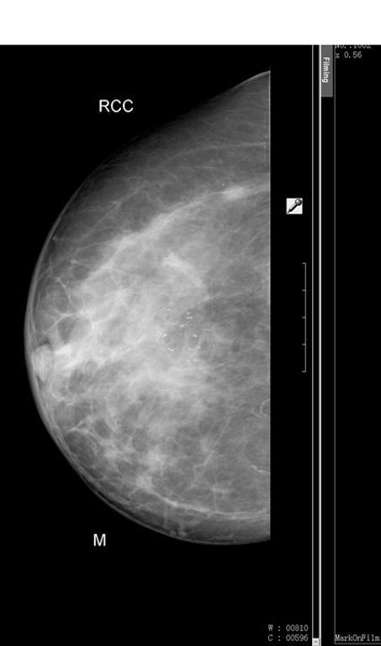
Application Task
EXAMPLE: Breast Cancer Screening or Prostate Cancer
Apply the Health Belief Model to Breast Cancer Screening in Australia.
Draw the Model and include MINIMUM 2-3 points for each heading.
This Photo by Unknown Author is licensed under CC BY-SA

Slide 53
Sources
Lockhart, E. (2010). Health Studies Stage 2A-b. Madeley: Print Publishing.
Image From: http://www.ohprs.ca/hp101/mod4/module4c3.htm

Slide 54
Quiz

Slide 55
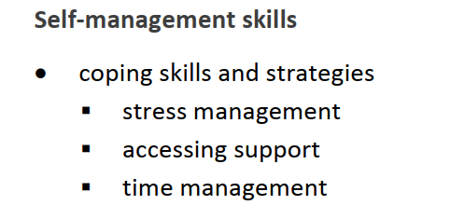
Syllabus points

Slide 56
Self Management Skills #1
Time management, stress management, accessing support

Slide 57
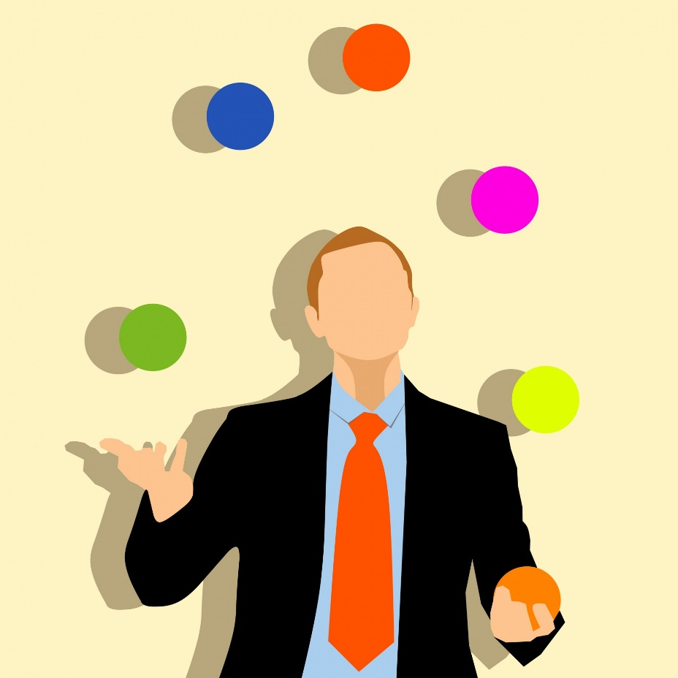
Skills Vs Strategies
What is a skill?
The ability to do something well.
What is a strategy?
A plan of action to achieve a major overall aim. (planning and directing actions or movements)

Slide 58

Coping Skills
There are 3 key coping skills that we will cover:
Stress Management
“A range of techniques used to control a person’s level of stress and reduce the physical and emotional burden caused.”
Time Management
“Effectively planning use of time to balance commitments and relaxation times. The ability to be organised and plan ahead of time to reduce stress and maintain calm.”
Accessing Support
“The ability to ask for help and successfully utilise services and/or people to gain assistance”.

Slide 59
Stress Management
What is stress???
https://www.youtube.com/watch?v=8sobA6G00tI
It’s a BIOLOGICAL RESPONSE to an External Stressor.
Lets have a read!!!! Page 86
Incorporates several body systems
Goal is to create a “coping behaviour”
Either successful or unsuccessful in producing an effective coping behaviour.

Slide 60
Discussion:
List some situations that cause you to feel anxious/worried/tense?
Exams, parent or teacher expectations, claustrophobic crowds of people, uncomfortable situations etc.
What did you do to help deal with these situations?
These are COPING STRATEGIES!
COPING: the ability of an individual to deal effectively with a difficult situation.

Slide 61
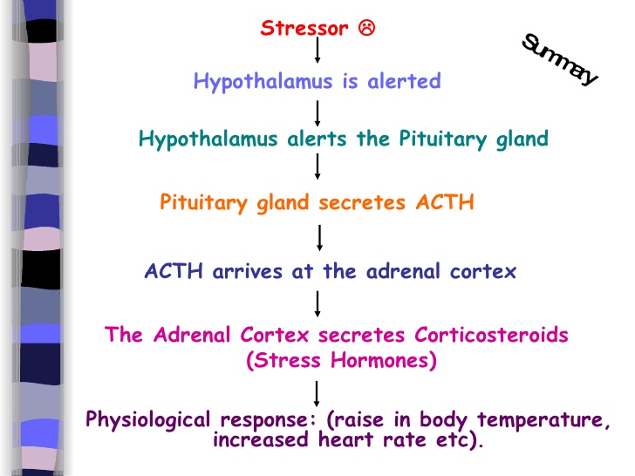
https://www.youtube.com/watch?v=v-t1Z5-oPtU 5 mins

Slide 62
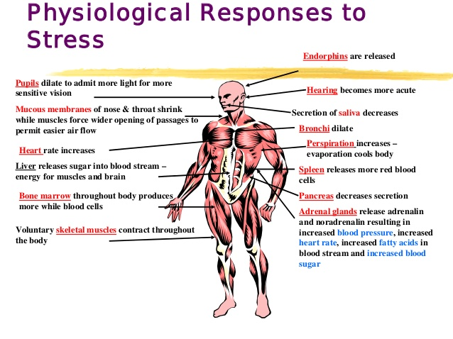

Slide 63
Stressor:
Can be either real or imagined
Environmental event
“set the stage” for the stress response to “kick in”.
Don’t cause the stress response
Ie. The same stressor/stimuli might cause one individual’s stress response to “kick in” and in another individual it won’t.

Slide 64
The Stress Response Process:
Everly & Lating, 2013 (page 86 textbook)
Kelly McGonigal
“ How to make stress your friend”
https://www.ted.com/talks/kelly_mcgonigal_how_to_make_stress_your_friend?language=en

Slide 65
Thoughts and Emotions:
Thoughts+Emotions=how the stressor is PERCEIVED.
Highly individual
How a person perceives an event determines if it becomes a stressor or not.
Eg: an athletics carnival
Can vary within an individual: IT’S DYNAMIC
As time goes on, situations that once caused the stress response may no longer elicit the same response.
EXAMPLE? Todd Sampson-BODY HACK (Underwater)

Slide 66
Stress Management
Strategies
People use these STRATEGIES (page 89) to set up a plan to deal effectively with their stress.
Skills
BUT they must also possess SKILLS to actually carry out their stress management plan.
For example: being assertive, the ability to say no, reflection, forgiveness, communication.

Slide 67
Stress management ideas (not examinable just for help)
Midnfulness – Smiling minds (free app)
High intensity exercise – Google search HIIT program
Yoga – Yoga with Adriene
Unplug – Don’t use devices of any kind for a timed period
Have a little faith
Peaceful settings
Do something for someone else

Slide 68
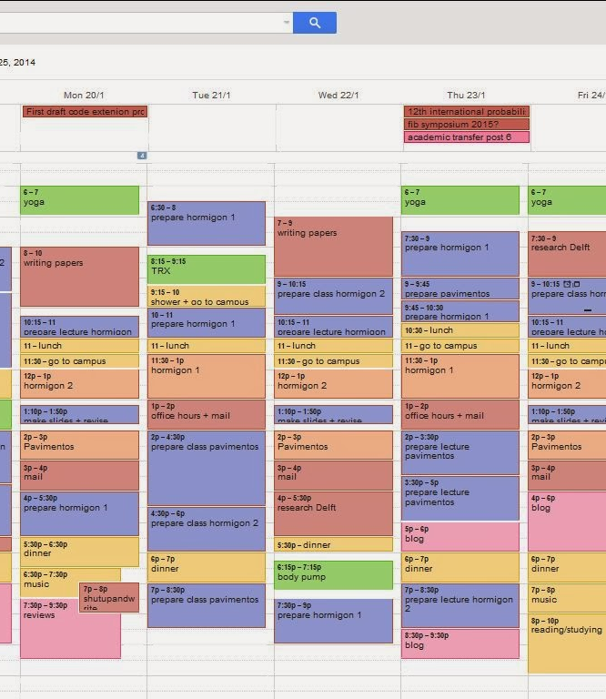
Time Management
If an individual manages their time well, they are able to reduce/avoid stress.
HOW??
Come and write on the board a way that people can manage their time effectively.
This Photo by Unknown Author is licensed under CC BY-SA-NC

Slide 69
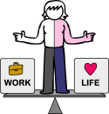
Time Management
In order to manage their time, an individual requires both
TIME MANAGEMENT STRATEGIES
And
TIME MANAGEMENT SKILLS
STRATEGIES: planning, prioritizing, work/life balance, lifestyle plan, delegation, organisation.
SKILLS: sticking to plans/timetables, being realistic when making plans, hard working, persistence, asking for help when needed, motivation skills, maintaining organisation.
This Photo by Unknown Author is licensed under CC BY-SA-NC

Slide 70

Accessing Support
An individuals ability to access support is determined by more than just knowing that the support is there.
There are 5 A’s:
Affordability- Can you afford to pay for the service?
Availability- Are the people you need available to help when you need them?
Accessibility-geographical: can you get there?
Accommodation-can the support service accommodate you and your needs? Flexibility? Understanding?
Acceptability-is the support system “personally” acceptable to you? Do you trust them? What are their personal characteristics like?

Slide 71
Accessing Support
The 5A’s determine whether or not a person is going to use different support systems.
QUESTION: What support systems are available to students at Kennedy?

Slide 72
REVISION QUESTIONS
Define and describe how skills and strategies are important for self management skills/stress reduction? (4 marks)
Explain 4 techniques for effective stress management (8 marks)

Slide 73
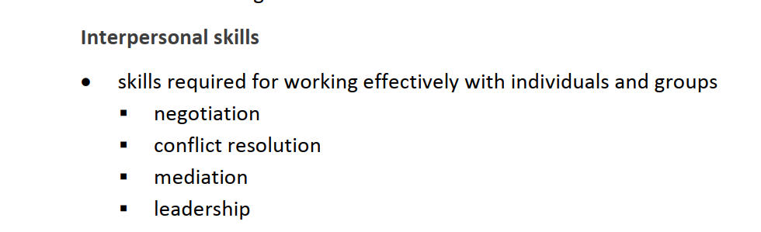
Syllabus points

Slide 74
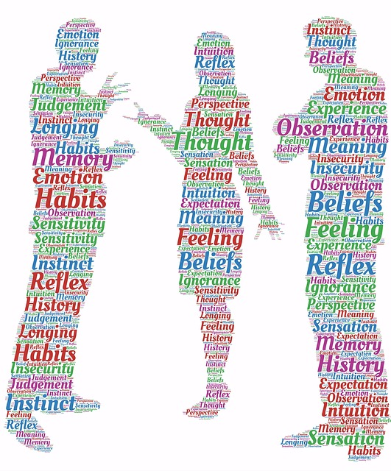
Self Management Skills #2
Groupwork, Conflict Resolution, Negotiation, Mediation, Leadership

Slide 75
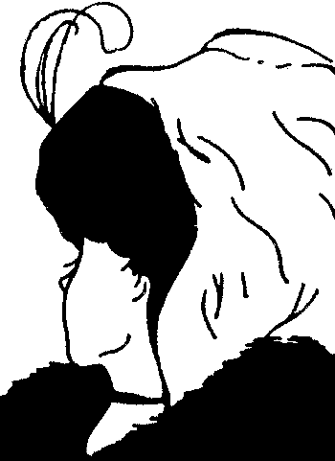
Groupwork
When working in a group, conflict is INEVITABLE.
Write on the board skills that are required for working effectively in groups/teams/individuals?
Perspective is everything
https://www.youtube.com/watch?v=cRcDfCafSYE
Conflict resolution, negotiation, mediation, leadership

Slide 76
Groupwork: Conflict Resolution
When conflict is resolved effectively:
Increased awareness/understanding of other group members
Increased group cohesion
Stronger mutual respect
Improved self awareness
Effective conflict resolution involved skills such as:
EMPATHY, ASSERTIVENESS, MANAGING EMOTIONS, MEDIATION & NEGOTIATION.
What is conflict?

Slide 77

Conflict Resolution (Continued)
It’s important to REMOVE the CONFLICT from the PEOPLE.
People can still love and respect each other while working through a conflict. (it shouldn’t become personal)

Slide 78
Steps in Conflict Resolution:
IDENTIFY the problem.
LOOK BEYOND the incident-what emotions are making this problem worse?
BRAINSTORM solutions.
CHOOSE a solution that works for everyone!
PLAN for the future so this conflict doesn’t happen again.

Slide 79
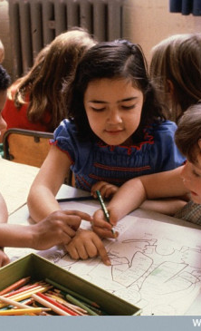
Groupwork: Mediation
MEDIATION: a negotiation to resolve differences that is conducted by some impartial party. The intervention is to bring about settlement and resolve conflict.
A MEDIATOR assists the two parties to create their own solution to resolve the conflict.
Communication
Help determine facts and agendas
Show impartiality and empathy
Use persuasion to help parties see the issue from the other perspective.
This Photo by Unknown Author is licensed under CC BY-NC

Slide 80
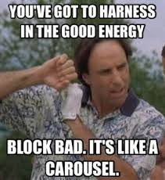
Skills For Effective Mediation
Maintain a positive attitude.
-set the tone for communication
Refocus the negative.
-change the topic when negative emotions overpower the discussion
Create a common enemy.
-parties with a common enemy are more likely to unite together.

Slide 81
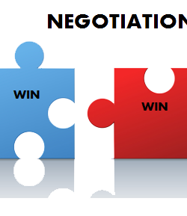
Groupwork: Negotiation
NEGOTIATION: The process of achieving agreement through discussion, used to resolve disputes. Negotiators bargain for individual or collective advantage.
People restore their relationship post-conflict, but there may still be issues to be discussed/sorted out.
Through negotiation, they can come to a resolve in a safe and cooperative way.
Negotiation is basically about UNDERSTANDING and ENGAGING with people more effectively.
This Photo by Unknown Author is licensed under CC BY-NC

Slide 82
Negotiation (continued)
Stages of Negotiation…
1. Preparation
Write out facts/opinions prior to the discussion
2. Discussion
Meet and discuss, both parties present their P.O.V
3. Clarification of goals
Rehash the main goal/priority of the discussion
4. Negotiate Outcome
Discuss options/outcomes/compromises.
Ensure everyone feels heard and understood
5. Agreement
Plan for the future, together select a solution to move forward
6. Implementation
Give it a go! Put the plan into action and review it early.

Slide 83
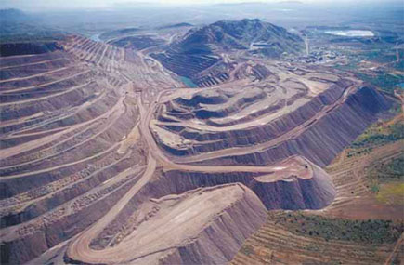
Example: Argyle Mines, Western Australia - land mark participation agreement between Rio Tinto and traditional owners
2014 saw the tenth anniversary of the landmark Argyle Participation Agreement between Rio Tinto and the traditional owners of the mine, the Gija and Mirriuwung people. When the Participation Agreement was signed a decade ago, it set a new benchmark in Australia for land use agreements between resource companies and traditional owners: it created not only income streams for future generations of local Aboriginal people, but also significant training, employment and business development opportunities and a voice for Aboriginal people in mining decisions affecting their interests. For example, during the negotiation of the Agreement, Argyle provided an undertaking that was probably unique in the history of the mining industry: Argyle would not proceed with its plans for an underground mine without the approval of the traditional owners, despite the fact that this was not required by law.

Slide 84

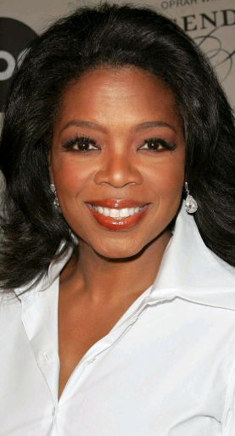
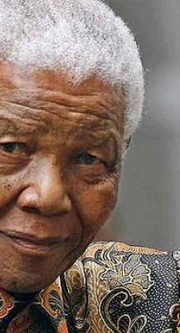
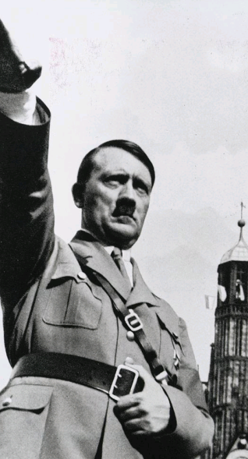
Groupwork: Leadership
What does a LEADER look like?
LEADER: a person who
guides, inspires & directs
others.

Slide 85
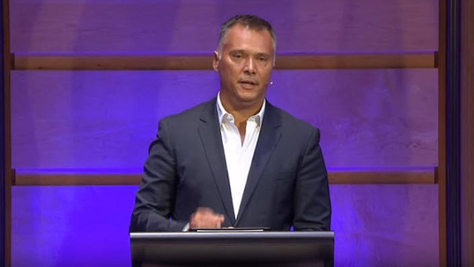
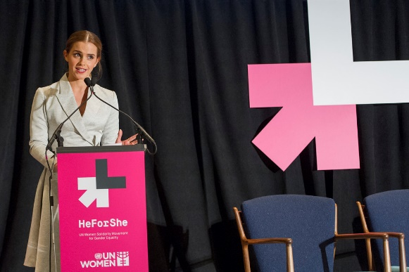
This Photo by Unknown Author is licensed under CC BY-SA-NC
Stan Grant- Professor of Global Affairs at Griffith University https://www.youtube.com/watch?time_continue=21&v=uEOssW1rw0I&feature=emb_logo – 8:34
IQ2 Racism Debate
Emma Watson https://www.youtube.com/watch?v=gkjW9PZBRfk
13:15
Addressing the UN
This Photo by Unknown Author is licensed under CC BY-NC-ND

Slide 86

Leadership – Does the previous demonstrate this?
Enlisting help and support from others to achieve a common goal or task.
Individuals beliefs, attitudes and thoughts can be changed through their interaction with other members of the group.
Leaders inspire others to become a “better version of themselves”
Leaders set the direction of the group.

Slide 87
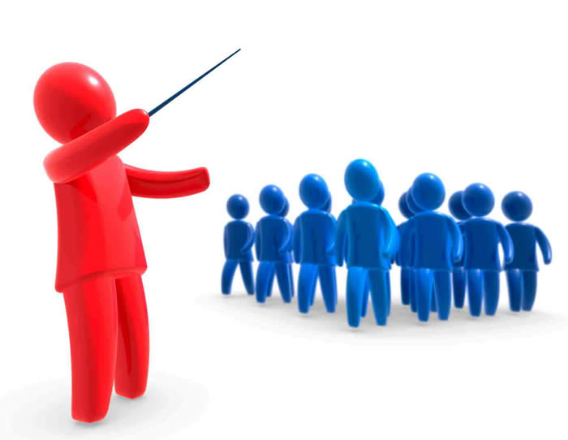
Leadership Styles
AUTOCRATIC - https://www.youtube.com/watch?v=U6SM057qEy4 1:14
“authoritarian” or “dictator”
Makes decisions without consulting others
Studies show this generally have the highest level of discontent.
What is an example of where autocratic leadership is beneficial?
Parent/child relationship-when the child does not have the capacity to make the decision themselves.
This Photo by Unknown Author is licensed under CC BY

Slide 88
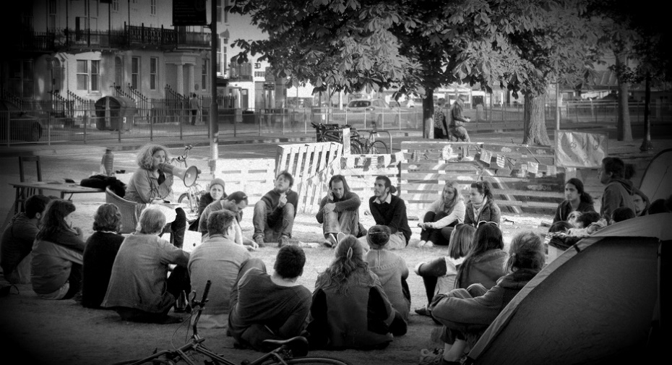
Leadership Styles
DEMOCRATIC - https://www.youtube.com/watch?v=Pcx6HLPtVZ0 “collaborative”
The leader involves the people in the decision-making.
Often the group votes or each person has their say, then the leader uses their information to make the decision.
Appreciated by the people (high level of content)
Is Australia a democratic Nation? How do we know this?
This Photo by Unknown Author is licensed under CC BY-ND

Slide 89
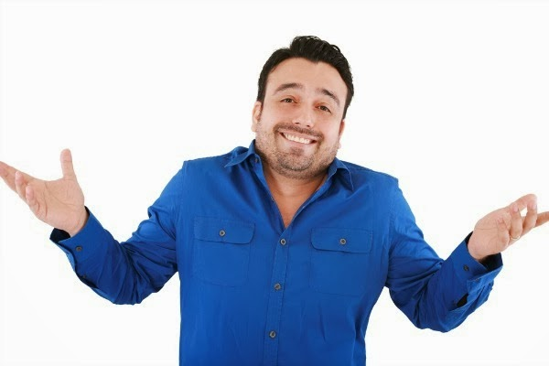
Leadership Styles
LAISSEZ-FAIRE (French: Non Interference) https://www.youtube.com/watch?v=cRC7ZFiLHmA
“casual” leadership
Minimal input by the leader, allows people to make their own decisions
Can often lead to disunity amongst group
When does this work well?
When the people are capable and motivated.
This Photo by Unknown Author is licensed under CC BY-SA

Slide 90
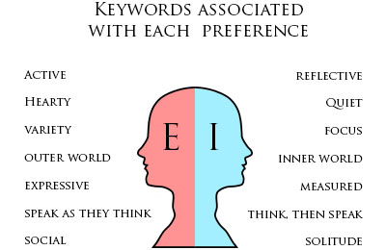
Groupwork: Personality Styles
EXTROVERT: People who get their
energy from other people and the
world around them.
INTROVERT: People who get their
energy from within themselves
Personality test https://www.16personalities.com/free-personality-test
This Photo by Unknown Author is licensed under CC BY-NC

Slide 91
Syllabus point

Slide 92
Personality Styles
Dr Debra Johnson’s experiment (1989)
Studied the blood flow in the brain
INTROVERTS: more blood flow in memory/analysing/planning and problem solving
EXTROVERTS: more blood flow as a result of sights/sounds/touch and taste.
http://www.theguardian.com/science/quiz/2012/mar/13/quiz-are-you-an-introvert

Slide 93
Introverts:
Communicate best one-to-one
Hesitate before sharing their opinion
Private and protective of their feelings, emotions and thoughts
Often take time to think before they respond
Often prefer writing over talking

Slide 94
Extroverts
Willingly share their opinions and ideas with others
Need constant attention from others
Usually good at public communication
Often the manager/leader organiser of the group

Slide 95
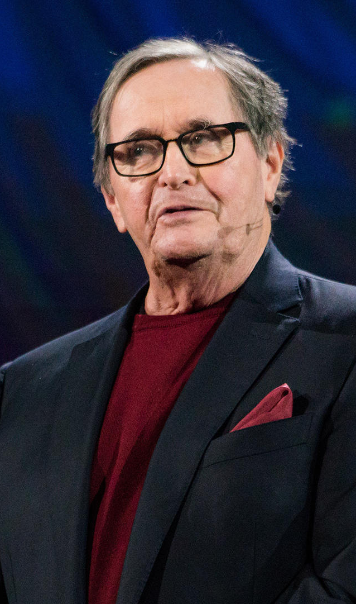
Labels are good but not everything
https://www.youtube.com/watch?v=qYvXk_bqlBk&t=550s
15:16 mins

Slide 96
Quiz
Why might an introvert find it difficult to communicate within the Australian culture? Explain why.
Describe the personality attributes of an extrovert and give 3 reasons why they might struggle to get along with an introvert.
Jump on the internet. Find 2 examples of leaders who fit into each leadership style. (Autocratic, Democratic and Laissez-Faire)

Slide 97
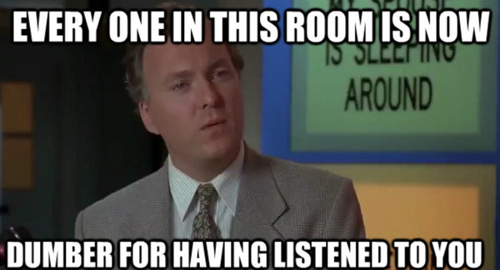
DEBATE
Should Marijuana be legalised in Australia?
Affirmative/Negative Sides
The class uses Mediation, Negotiation and Leadership to bring conflict resolution within your team
3 Judges will be chosen
Marks allocated ( /10) for
Effective group work
Leadership
Negotiation
Resolution
Conflict resolution
Debate will be judge by teacher

Slide 98
Sources:
http://www.islamicity.com/global/images/photo/IC-Articles/Heart-Love-Sky-Hands-Silhouette__1920x1200.JPG
http://img.thesun.co.uk/aidemitlum/archive/01652/SNF1134HIT--_1652387a.jpg
http://www.daviddibble.com/media/2011/02/Oprah_Winfrey_Biography.jpg
http://cdn1.theodysseyonline.com/files/2015/03/28/635631062252597205103151809_introvert-mind.jpg
Lockhart, E. (2010). Health Studies Stage 2A-b. Madeley: Print Publishing.
http://www.slideshare.net/ghaiath/stress-main-presentation-pdf

Slide 99
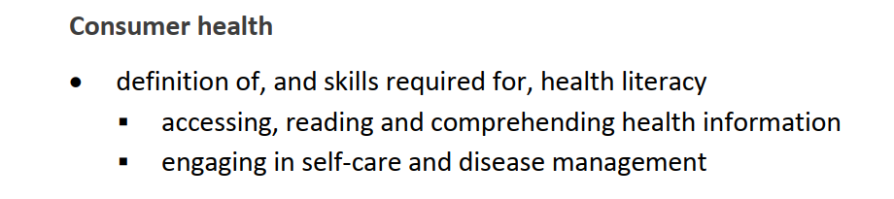
Syllabus points

Slide 100
Health literacy
Determinants of Health

Slide 101
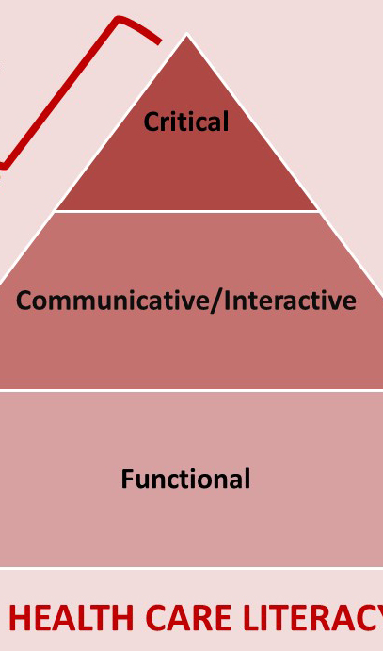
Health Literacy
https://www.youtube.com/watch?v=JXvGToFbZb4 6 mins – What is Health Literacy

Slide 102
Definitions
Health Literacy
“The ability of individuals to access and understand health information and to use this information to make informed, wise decisions.”
Critical Literacy
The awareness of the relationship between language and power. People need to look at health information with discernment and judgment in order to ensure that they are not manipulated by the media to act in certain ways.

Slide 103
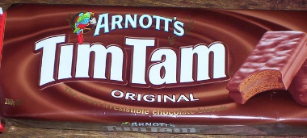
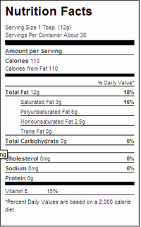
Levels of Health Literacy
Level 1:
Functional Health Literacy
A person will be at this level of health literacy if they are able to choose products and services for personal use, understand instructions on labels, and have some knowledge of risks.
This Photo by Unknown Author is licensed under CC BY-NC-ND
This Photo by Unknown Author is licensed under CC BY-SA-NC

Slide 104
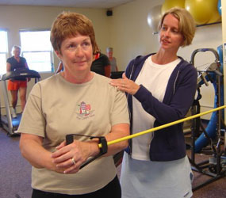
Levels of Health Literacy
Level 2:
Interactive Health Literacy
At this level individuals will seek to improve their own personal skills and strategies to act on health advice.
This Photo by Unknown Author is licensed under CC BY-SA

Slide 105

Levels of Health Literacy
Level 3:
Critical Health Literacy
At this level, people will have the cognition and skills to “initiate social and political action for health outcomes”. These people use their understanding of social, environmental and economic determinants of health to seek change for the good of the community.

Slide 106
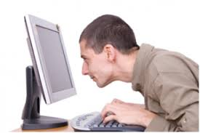
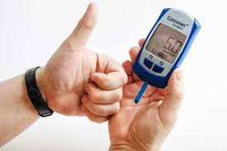
Skills for Health Literacy
In order to be health literate, they must be able to:
1. Access, read and comprehend health information
2. Engage in self-care and disease management.

Slide 107
Accessing
Being able to access means “to be able to obtain or retrieve the information you need”.
To access health information a person needs to be able to locate health information. This includes selecting the most appropriate information, considering validity, reliability and credibility of the author.
The individual must also be able to have the rights to access information about their health.

Slide 108
Accessing
Permission to access?
How would you access health information?
What if a person wanted to research whether they should immunise their children?
“should I immunise my child” v “what are the benefits and risks associated with immunisation”.
Difference in sources?

Slide 109
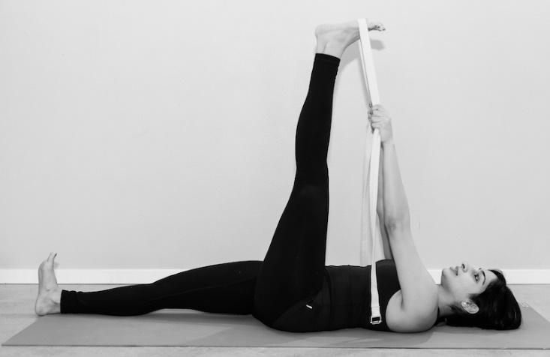
Reading
A person needs to be able to read health information that they have access to.
Why is this an issue?
ESL
Medical jargon
Target audience
Physio “Just do some proprioceptive neuromuscular facilitation three times a week for 2 weeks”
This Photo by Unknown Author is licensed under CC BY-NC-ND

Slide 110
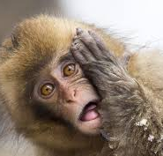
Comprehending
What does comprehend mean?
People must be able to put their health advice into practice.
Who has left the doctor before feeling confused?
Many patients do not understand what their doctor is advising them to do for a variety of reasons. This can lead to people with inadequate health literacy not being able to comprehend the information that they have been given.

Slide 111
Self Care
Definition: The practice of taking action to preserve or improve one's own health.
Physical
Mental
Emotional
Social
Psychological
Self care will improve and restore overall health.
Pg 56 has a more comprehensive definition

Slide 112
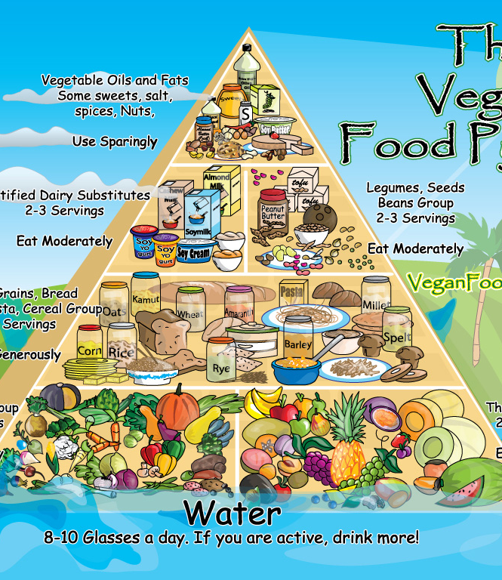
Self Care
Self care also includes activities that prevent or treat disease.
E.g.
Eating well
Exercising
Self-Screening (breast checks/skin checks)
Taking vitamins
Relaxation techniques
This Photo by Unknown Author is licensed under CC BY-NC-ND

Slide 113
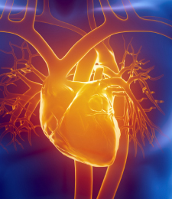
Disease Management
Disease management refers to an individual learning to manage a chronic disease.
What is a chronic disease?
“Illness that is prolonged in duration, does not usually go away by itself, and is rarely cured completely”.
E.g. Cancers, cardiovascular disease, respiratory disease and diabetes.
The patient will learn to take responsibility of understanding how to care for themselves and their ailment. This will allow them to avoid potential problems, or worsening of the current problem.
This Photo by Unknown Author is licensed under CC BY

Slide 114
Disease Management
Disease management: Use a group of interventions to prevent or manage the chronic conditions.
Goal: Promote self management of all patients, and to help the individual work with health professionals to manage their condition.
Outcome: Less reliant on health professionals, spend less time in hospital, patients are encouraged to learn disease management principles.
This Photo by Unknown Author is licensed under CC BY-NC-ND

Slide 115

Disease Management Principles
1. Care Planning
Patients work with health professionals to develop a detailed disease management plan. Will consist of types of care needed, and guidelines for monitoring, check ups and medication.
2. Self-Monitoring
Patients are taught the symptoms of their condition, and how to monitor themselves for signs and symptoms.
3. Self-Administered Treatment
Once patients can self-monitor, they can be taught to administer their own medication/treatment.

Slide 116
Disease Management Principles
4. Allied Health Professionals
The patient will remain in contact with professionals such as nutritionists, physio’s and psychologists to support their management of the disease.
5. Emergency Contact
It is encouraged for patients to have contact details of their GP, specialist and pharmacist. This allows them to be independent whilst having the ability to get emergency help when needed.
6. Review
Regular appointments with a health care professional to monitor their progress, adjust treatment plans and refer for specialised monitoring (e.g. x-ray/blood tests/ultrasound).

Slide 117
Health Literacy report
WHO 2009 report on Health literacy
See highlighted sections that has directly linked content
Other areas will be very useful for further understanding
Please read – See Seta under Health Literacy lessons for document

Slide 118
Quiz

Slide 119
Source
Lockhart, E. (2010). Health Studies Stage 2A-b. Madeley: Print Publishing.
World Health Organisation, 2009 Health Literacy And Health Promotion - World Health Organization

